Slide 1
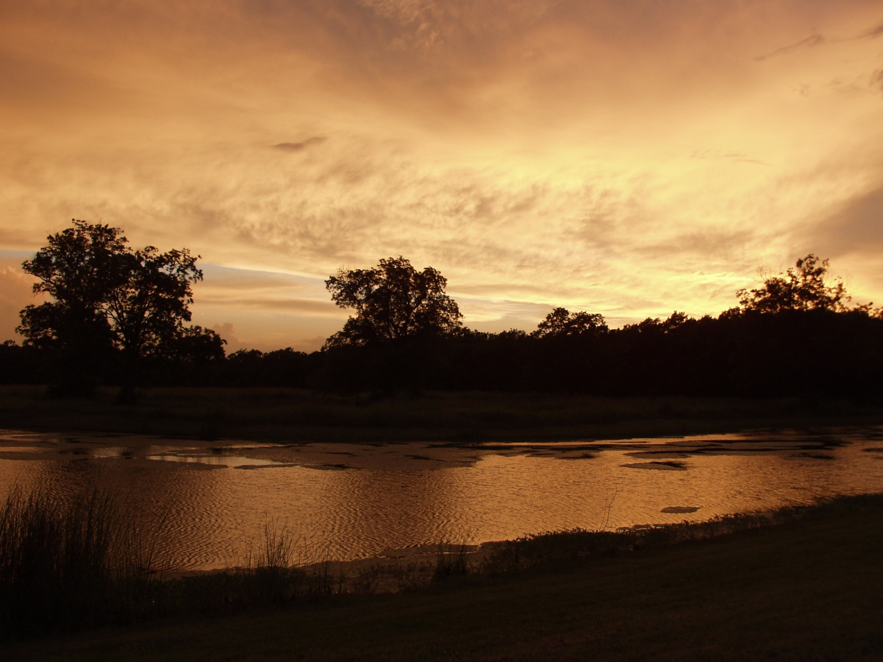
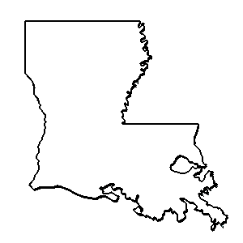
ouisiana
Anthology

Slide 2
Liberty in Louisiana James Workman

Slide 4
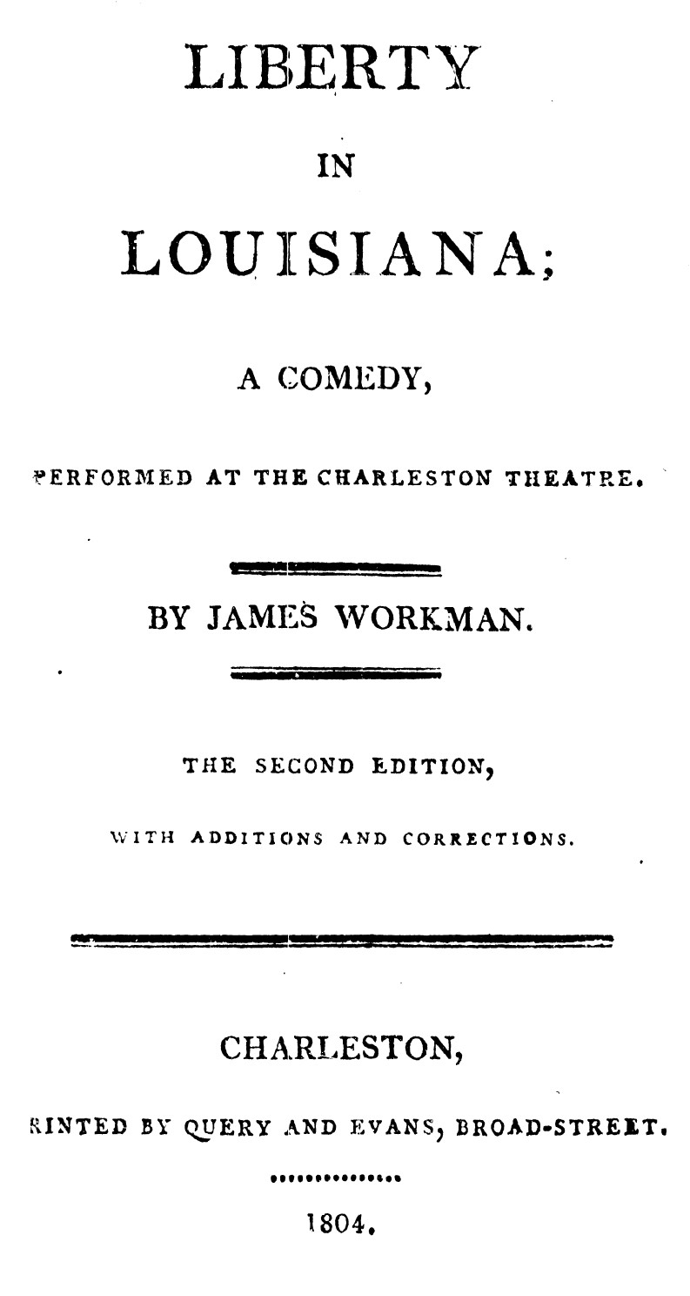

Slide 5
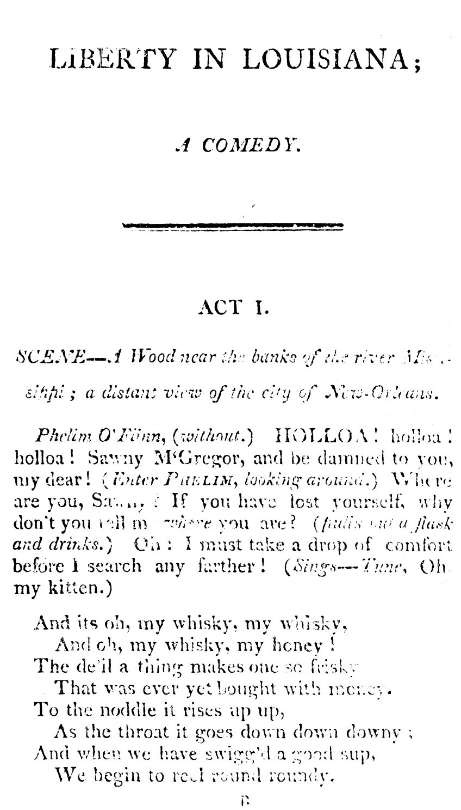

Slide 6
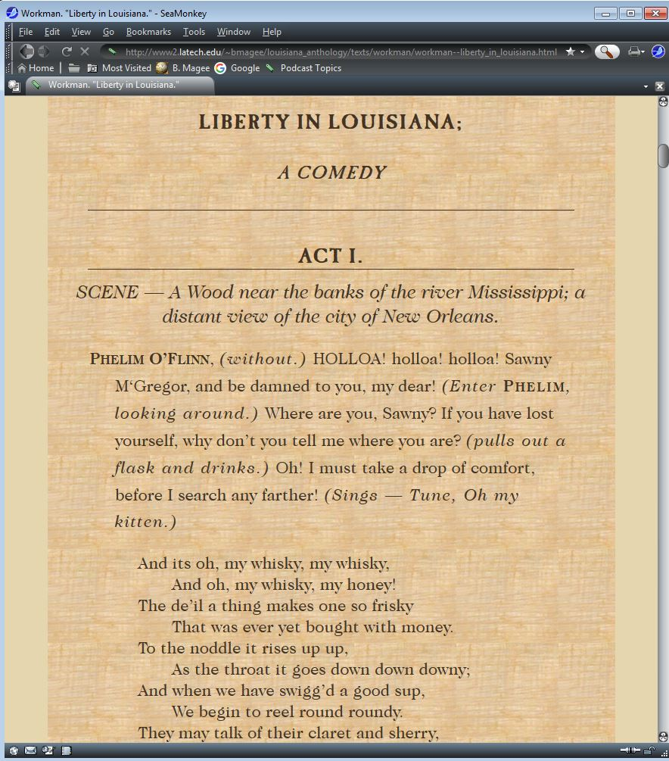

Slide 7
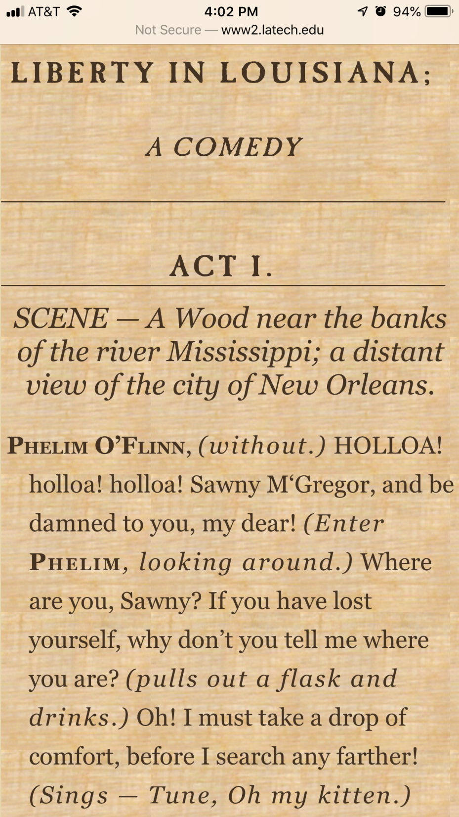

Slide 8
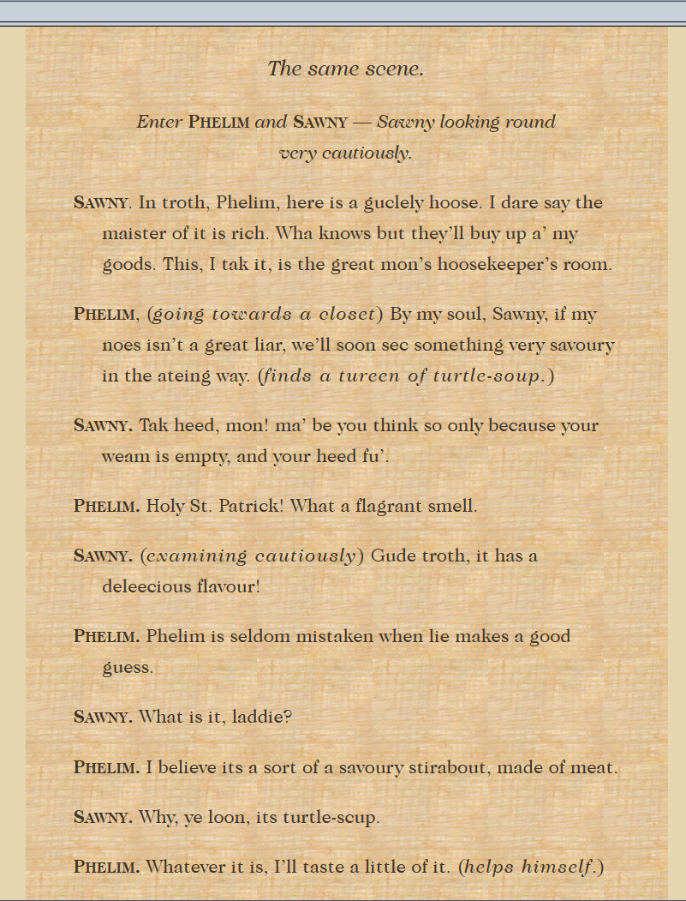

Slide 9
James Workman
Born in Caven, Ireland.
Earned his law degree, 1789.
Settled in Charleston, 1801-1802.
Associated with the Federalist paper, the Courier, in Charleston.
Became a citizen, May 21, 1801.

Slide 10
Workman in Louisiana
Moved to New Orleans right after the Louisiana Purchase, 1804.
Appointed Judge of the County of Orleans, May 1805.
Named to a committee start a Protestant church in New Orleans, June 1805.
Helped organize the Mexico Association, intended to “liberate” Mexico. Contacted by Aaron Burr, 1805.
Sided with Burr in freeing the men arrested for treason by Gen. James Wilkinson, 1807.

Slide 11
Liberty in Louisiana
Probably the earliest play about Louisiana in English.
Performed in Charleston, SC, New York, Philadelphia, and Savannah. 1804-1805.
We don’t know if it was ever performed in New Orleans.

Slide 12
Synopsis
Most of the characters are stock figures representing the old European order.
Two wandering picaros, the Irish Phelim O’Flynn and the Scottish Sawny M’Gregor initiate the action.
Soon they encounter the corrupt and foolish Spanish Judge Don Bertoldo de la Plata, his vain wife Señora de la Plata.
At risk is the young heiress Laura, the innocent yet intelligent, vivacious ward of Don Bertoldo.

Slide 13
The Plots against Laura
Comedy of manners.
Phelim finds out about Laura, the rich heiress.
Impersonates Captain O’Brien, the fiancé she’s never met.
Judge de la Plata wants to elope with Laura.
Señora de la Plata conspires with Phelim to thwart her husband and have the Captain to herself.
Theresa helps marry Phelim to the pregnant Lucy Margland, whom he’d abandoned in Tennessee.
The American General overrules Plata’s plot.

Slide 14
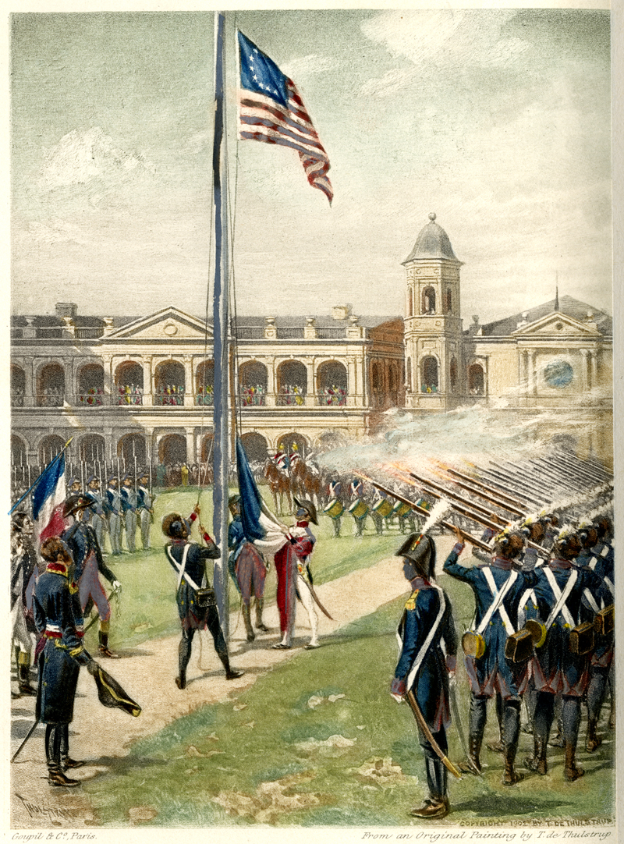

Slide 15
Themes
Federalist perspective.
Corruption of Spanish rule. The judge takes the mordida in all his cases.
Spanish rule is also monarchical—governs on behalf of the aristocracy.
The honesty of American rule.
No slaves, no Native Americans, few of the lower classes.
The blessings of liberty. But liberty as the Americans see it. Preserves the weak from the strong, but also preserves property.

